Slide 1
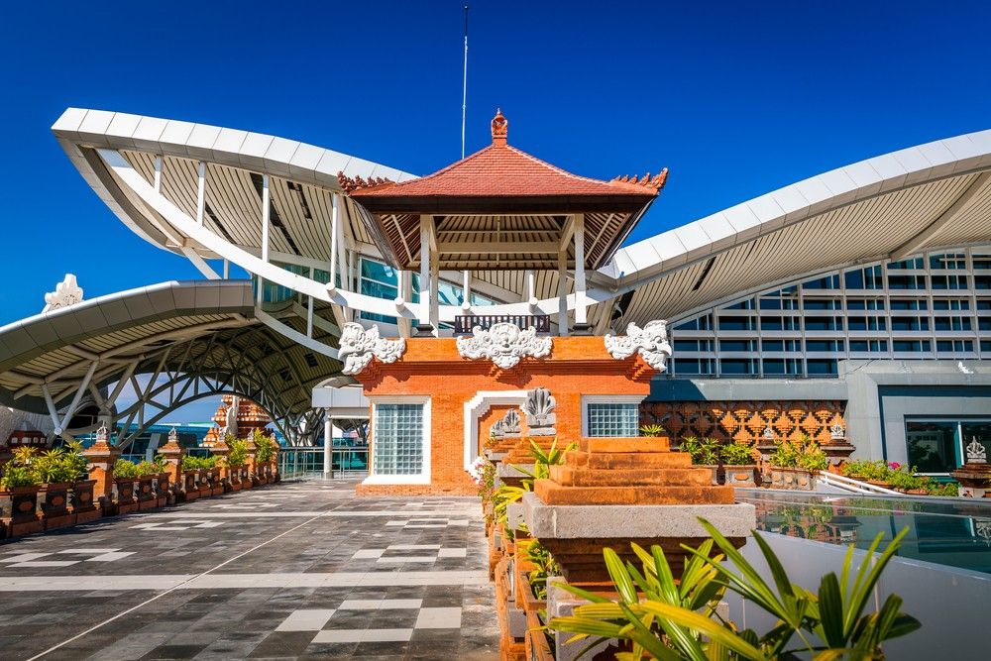
Web based Document control system (Study case : Angkasa Pura I Ltd.)
Final Presentation II
By
Yoga Permana Tanaya (E1400464)
Aufar Rahman (E1200241)

Slide 2

Company Background
Notes:
Aufar
PT Angkasa Pura I (Persero) provides airport management and other airport services in Indonesia and internationally. It operates and manages 13 airports in Central and Eastern part of Indonesia.

Slide 3

Project Background
DIVISION I
Valid or not?
DIVISION II
QUALITY MANAGEMENT DIVISION
Distribution
DIVISION III
DIVISION IV
Sorting
Storing
Notes:
Aufar

Slide 4
Existing System Flowchart
Notes:
Aufar

Slide 5
The Constraint With
The Existing System
Notes:
aufar

Slide 6
Notes:
aufar

Slide 7
Benefits of the Project
Notes:
aufar

Slide 8
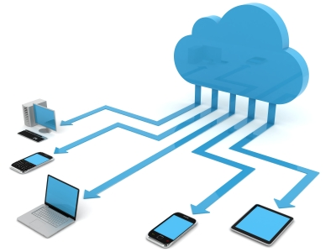
Easy to list the document in the company
2 Persons /Only admin and user
Easy to access
± 12 Days of work
Easy to Monitor
Notes:
aufar

Slide 9
Project Objectives
Improvement on Quality Management Department.
Improve work efficiency.
Reduce corporate spending and support Go Green program from Angkasa Pura I Ltd.
Facilitate to be easy accessed documents.
Notes:
aufar

Slide 10









Software/Hardware Requirements
Notes:
Yoga

Slide 11
Functional Overview
Admin | User
Resubmit Documents / Achieve | Submit Documents / Achieve
Edit Documents | Edit Documents
Resubmit Support Achieve | Submit Support Documents
Edit Support Achieve | Edit Support Documents
Delete Support Achieve | ✗
Delete Document | ✗
Make report | ✗
Download Document | Download Document
Resubmit External Document | Submit External Document
Edit External Document | Edit External Document
Delete External Document | ✗
Login | Login
Logout | Logout
Register Admin | ✗
Register User | ✗
Change Password | Change Password
Sort Documents | Sort Documents
Verify Documents | ✗
Notes:
Yoga

Slide 12
Non Functional Overview
No. | Non Functional
1 | Availability
2 | Security
3 | Maintainability
4 | Testability
Notes:
Yoga

Slide 13
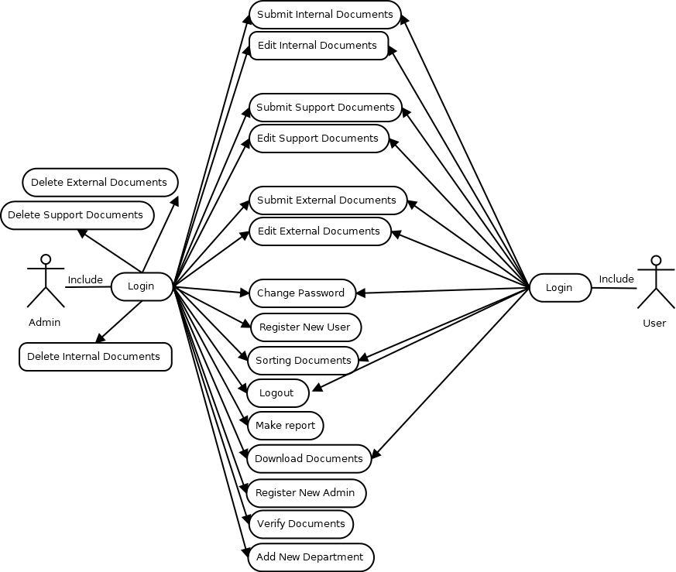
Over all Use Case Diagram
Notes:
Aufar

Slide 14
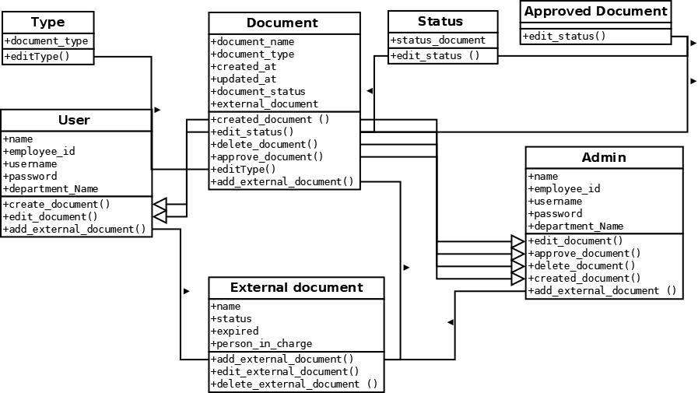
Class Diagram
Notes:
Yoga

Slide 15
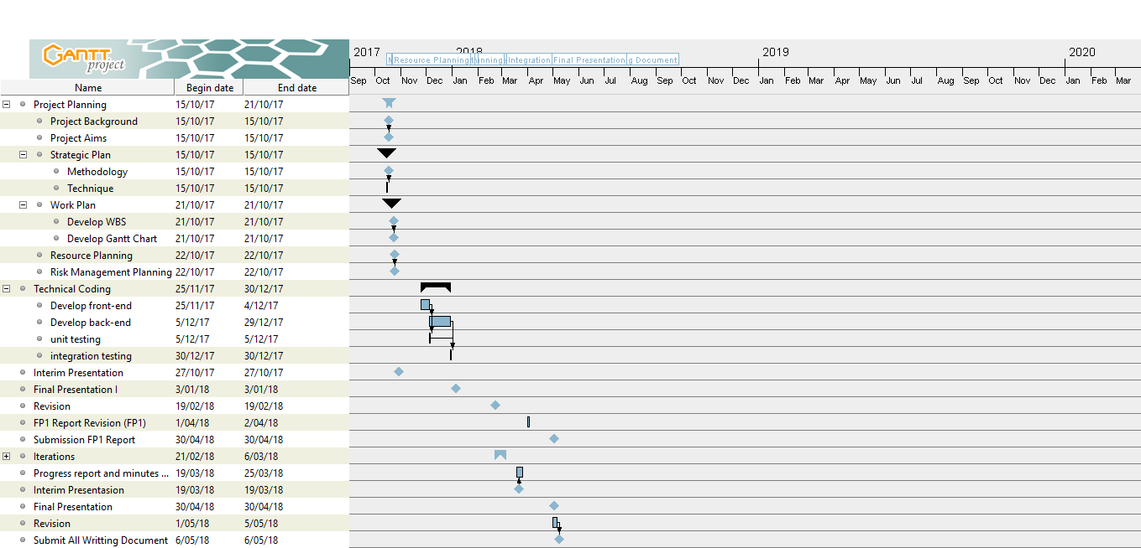
Project Gantt chart
Notes:
aufar

Slide 16
Unique design
The Web Apps work privately in a company
Can overwrite the files that was attached inside the system
Only the employee in the company could operate the apps
Notes:
Yoga

Slide 17
Review and Evaluation of the Project
Overall the system is done at the peak of the development stage
Waiting for the testing result in that company
Report Writing
Notes:
Yoga

Slide 18
Short Comings & Solutions
Lack in Writing Documentation Report Knowledge
Lack of knowledge using Codeigniter 3 Framework in developing a Web Application
Communication
Team Work
Time Management

Slide 19
Constraints of the Application
Submission Module still incomplete
Lack in security
Couldn’t Track the history that each document edited

Slide 20
Summarize of the Web Apps

Slide 21
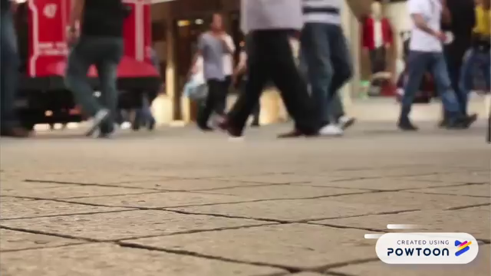

Slide 22

Lets See The System
;)

Slide 23
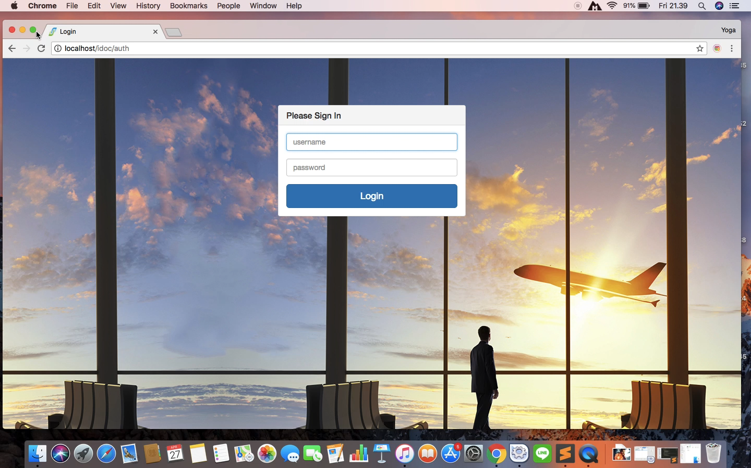

Slide 24
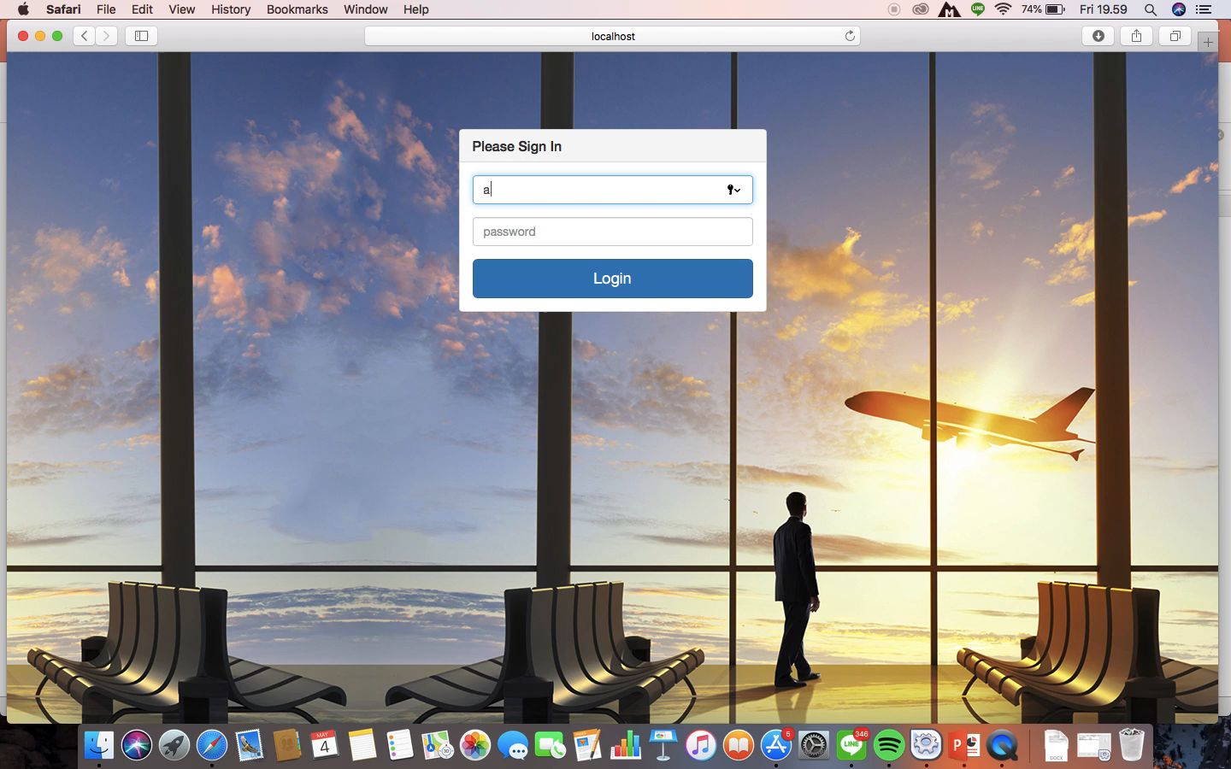

Slide 25


